Slide 1
Advanced Web Programming
PHP ARRAYS

Slide 2
PHP Arrays
There are three different kind of PHP arrays
Numeric array-An array with a numeric index. Values are stored and accessed in linear fashion
Associative array-An array with strings as index. This stores element values in association with key values rather than in a strict linear index order.
Multidimensional array-An array containing one or more arrays and values are accessed using multiple indices

Slide 3
Numeric Array
These arrays can store numbers, strings and any object but their index will be represented by numbers.
By default array index starts from zero.

Slide 5
Associative Arrays
The associative arrays are very similar to numeric arrays in term of functionality but they are different in terms of their index.
Associative array will have their index as string so that you can establish a strong association between key and values.
Creating Associative Arrays gives you a good way to use labels as the key in the array items instead of using numbered keys that increment automatically.
This way you can use a word that has meaning to you as key.

Slide 6
Associative Arrays
Have the ability to ‘associate a value’ with an array item
It takes any number of comma-separated key => value pairs as arguments
The key can either be an integer or a string.
The value can be of any type.

Slide 7
Creating an Associative Array

Slide 8
Creating an Associative Array

Slide 10
Output

Slide 11
Loop Through an Associative Array
The foreach construct provides an easy way to iterate over arrays.
Foreach works only on arrays and objects, and will issue an error when you try to use it on a variable with a different data type or an uninitialized variable.
There are two syntaxes:

Slide 12
For each example – Syntax 1
Loop through a Numerical Array

Slide 13
For each example – Syntax 2
Loop through an Associative Array

Slide 14
Loop Through an Associative Array
Output – from last slide

Slide 15
Multidimensional Arrays
A multi-dimensional array each element in the main array can also be an array.
And each element in the sub-array can be an array, and so on.
Values in the multi-dimensional array are accessed using multiple index.
Suppose you had this information in tabular form that you wanted to represent in a suitable data structure.

Slide 16
Multidimensional Arrays
This example shows that now $shop array, in fact, contains three arrays.
As you remember, to access data in one-dimensional array you have to point to array name and index.
The same is true in regards to a two-dimensional array, with one exception: each element has two indexes –row and column.

Slide 17
Multidimensional Arrays
To display elements of this array we could organize manual access to each element or make it by putting For loop inside another For loop:
See the code on the next slide

Slide 19
Multidimensional Arrays
The output for that code is as follows:

Slide 20
Combining Multidimensional and Associative Arrays
Perhaps, instead of the column numbers you prefer to create their names. For this purpose, you can use associative arrays.
The following code will store the same set of flowers using column names:

Slide 21
Combining Multidimensional and Associative Arrays
It is easier to work with this array, in case you need to get a single value out of it.
Necessary data can be easily found, if you turn to a proper cell using meaningful row and column names that bear logical content.
However, we are loosing the possibility to use simple for loop to view all columns consecutively.

Slide 22
Combining Multidimensional and Associative Arrays
You can view outer numerically indexed $shop array using the for loop.
Each row of the $shop array is an associative array.
Hence, inside the for loop you need for each loop.
Also you can get each element from associative array manually:

Slide 24
Multidimensional Associative Arrays
The output for that code is as follows:

Slide 25
Three Dimensional Arrays
You don’t have to be limited by two dimensions: the same way as array elements can contain other arrays, these arrays, in their turn, can contain new arrays.
Three-dimensional array is characterized by height, width, and depth. If you feel comfortable to imagine two-dimensional array as a table, then imagine a pile of such tables. Each element can be referenced by its layer, row, and column.
•If we classify flowers in our shop into categories, then we can keep data on them using three-dimensional array. We can see from the code below, that three-dimensional array is an array containing array of arrays:

Slide 26
Three Dimensional Arrays

Slide 27
Three Dimensional Arrays
As this array has only numeric indexes, we can use nested for loops to display it:

Slide 28
Three Dimensional Arrays
The output for this code is as follows:

Slide 29
Three Dimensional Arrays
This way of creating multidimensional arrays allows to create four and five dimensional arrays.
Syntax rules do not limit the number of dimensions, but the majority of practical tasks logically correspond to the constructions of three or less dimensions.

Slide 30
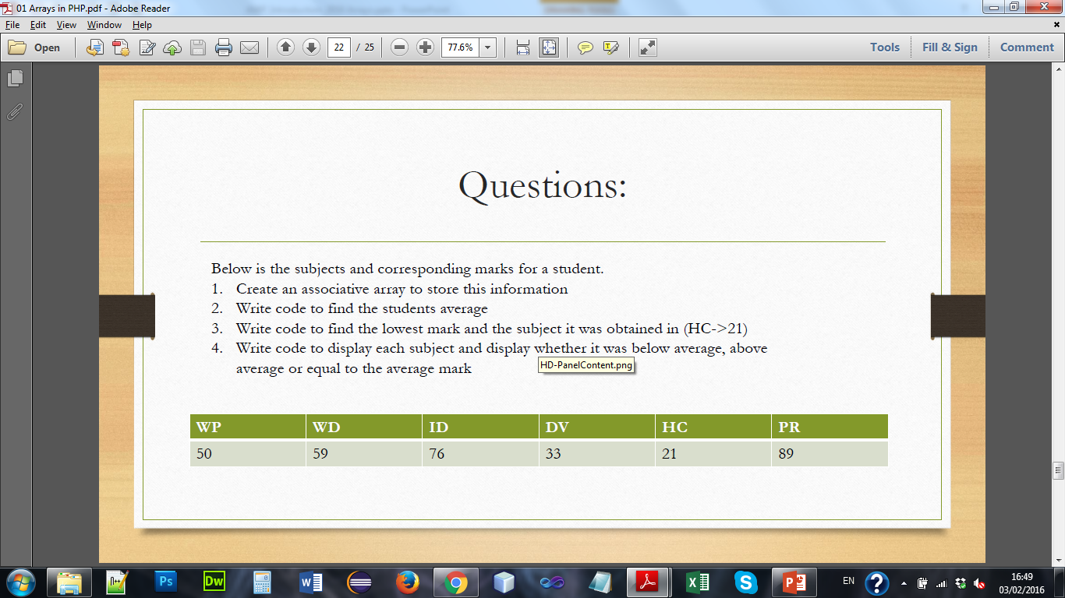
Question A
Below is the subjects and corresponding marks for a student.
Create an associative array to store this information
Write code to find the students average
Write code to find the lowest mark and the subject it was obtained in (HC->21)
Write code to display each subject and display whether it was below average, above average or equal to the average mark

Slide 31
Question A
The output might look something like this:

Slide 32
Question B
Write code to generate the table below –it should contain 10 students starting at K001-K0010, associated with each student is a set of six results these results should be randomly assigned values in the range 1-100 and is associated with a subject name.
Write the code to display the table
Add a new column (average) on for each student it should contain the average grade for each student, display the table with this new data
Add a new row (average) on for each subject it should contain the average grade obtained in the subject, display the table with this new data

Slide 33
Question B
Calculate and display the class average
Print the data so that any results < 40 is displayed in red
Print the knumbers of students who fell below the class average and the number of students who fell below average.

Slide 34
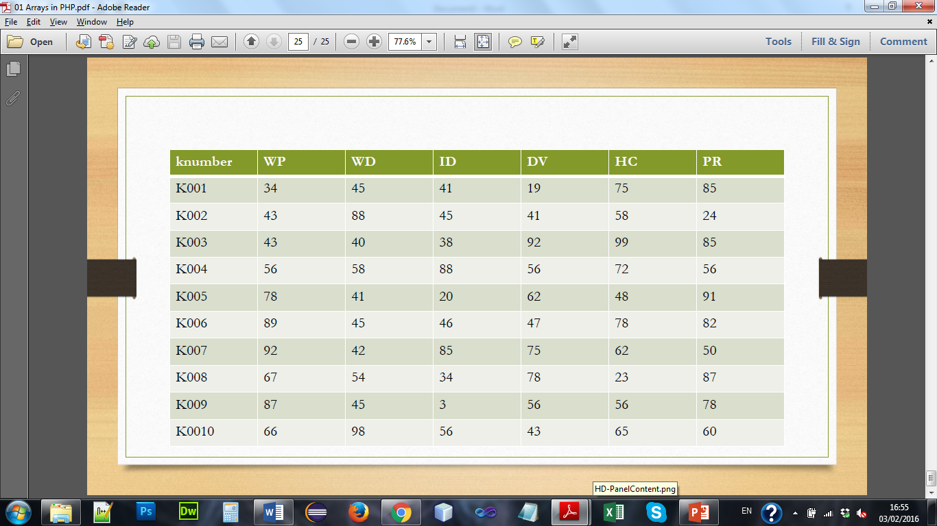

Slide 35
Question B
The output might look something like this (note that this exercise uses random data, so the figures will differ each time you run it).

